Slide 1

Analyzing amazon sales Data
Unified Mentor Data analytics Internship Project
T Shiva Kumar Yadav

Slide 2
Overview
This project focuses on analyzing Amazon sales data to gain insights into product performance, customer behavior, and market trends.
By leveraging data analytics techniques, the project aims to provide valuable insights for sellers, marketers, and decision-makers in optimizing sales strategies and enhancing business performance on Amazon.

Slide 3



Tools and Technologies
Language: Python
Libraries : Pandas, NumPy, Matplotlib, Seaborn
Environment: Jupyter Notebook

Slide 4
Deliverables:
Jupyter Notebook with code and explanations.
Visualizations showcasing segmentation and insights.
Concise report summarizing analysis and recommendations.

Slide 5
Details of data
Columns: 'Region', 'Country', 'Item Type', 'Sales Channel', 'Order Priority', 'Order Date', 'Order ID', 'Ship Date', 'Units Sold', 'Unit Price', 'Unit Cost', 'Total Revenue', 'Total Cost', 'Total Profit’.
Range Index: 100 entries, 0 to 99.

Slide 6
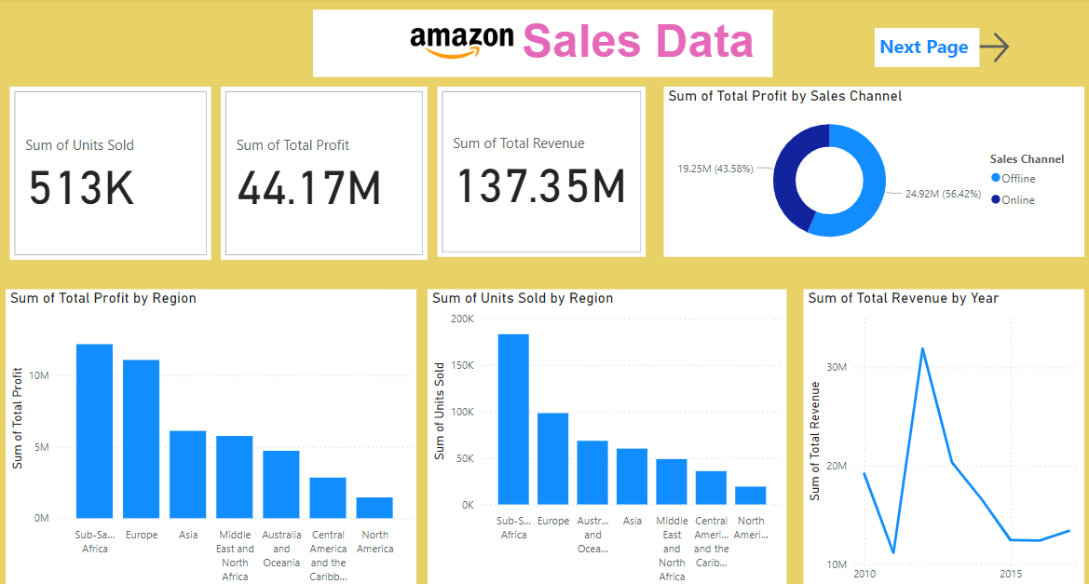
My Dashboards Using Power Bi Tool:

Slide 7
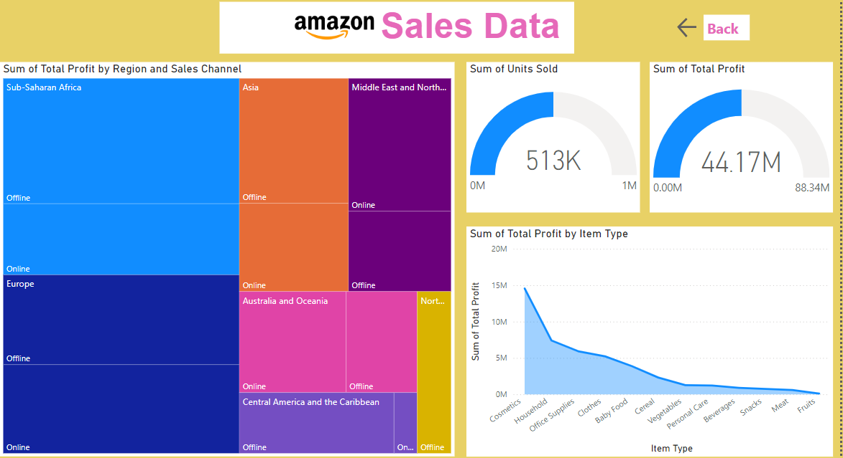

Slide 8
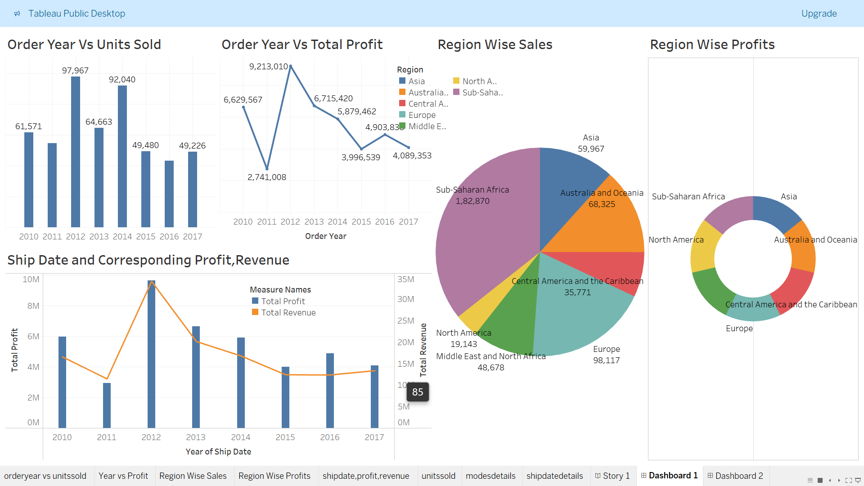
My Dashboards Using Tableau

Slide 9
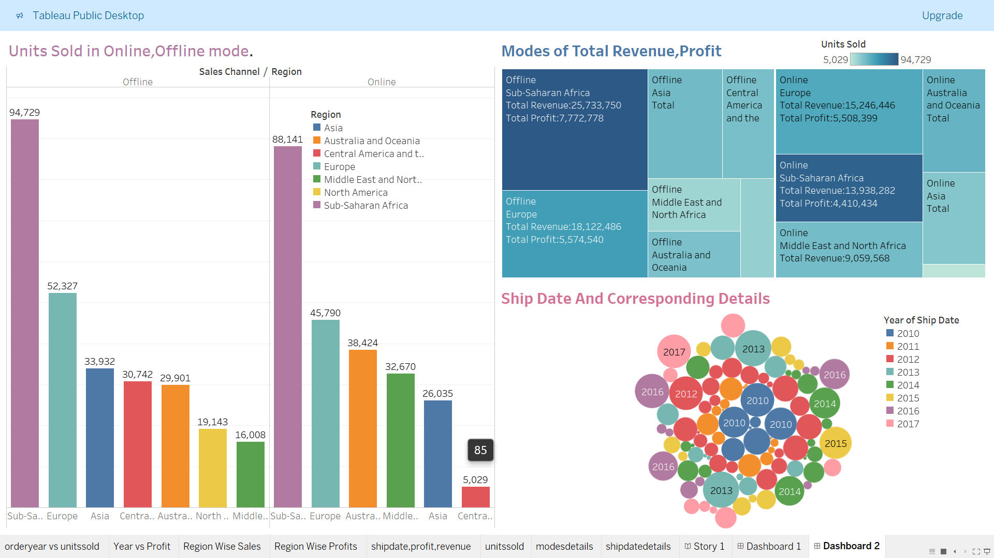

Slide 10
Thank you

